Slide 1
React
Frontend Library

Slide 2
What is React
Open source library for building user interface
Not a framework
Focus on UI
Rich ecosystem

Slide 3
Why learn React ?
Created and maintained by Facebook
Huge community
The most in demand skillset

Slide 4
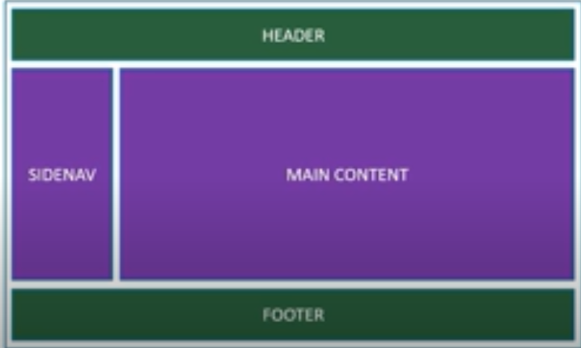
Component Based Architecture

Slide 5
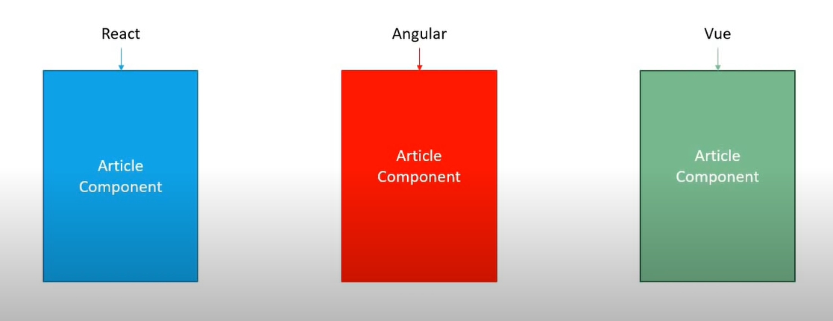
Reusable code

Slide 6
React is Declarative
Tell React what you want and React will build the actual UI
Another is Imperative
i.e: u goes to an artist and have to tell him everything
React will handle efficiently updating and rendering of the components
DOM updates are handles gracefully in React

Slide 7
More on React
Seamlessly integrates react into of your applications
Portions of your page or a complete page or even an entire application itself.
React native for mobile applications

Slide 8
These types of framework has these things in common:
Component
Routing
State management

Slide 9
Content:
Hello World
Folder structure
Component (Functional and Class)
JSX
Props

Slide 10
Getting started
In system using npx-create-react-app .
Or in codesandbox

Slide 11
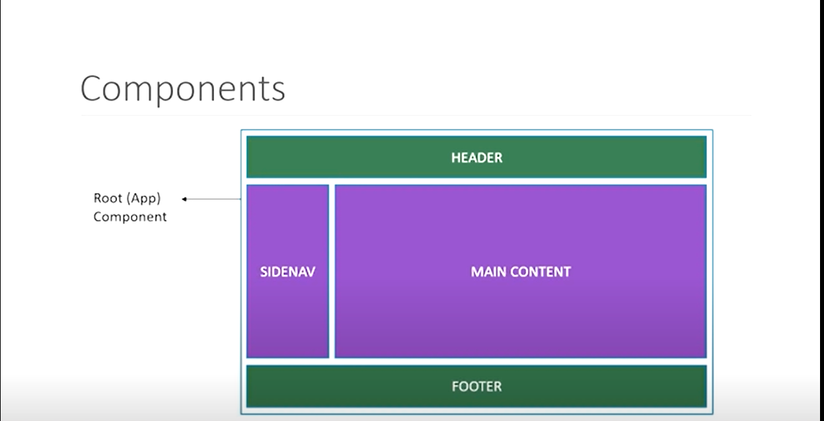
Components in React

Slide 12
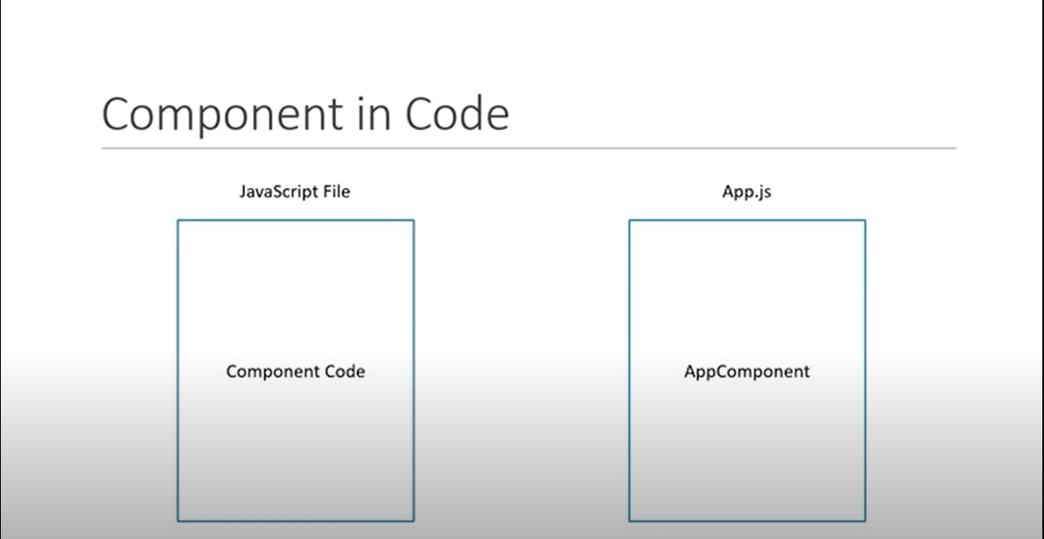

Slide 13
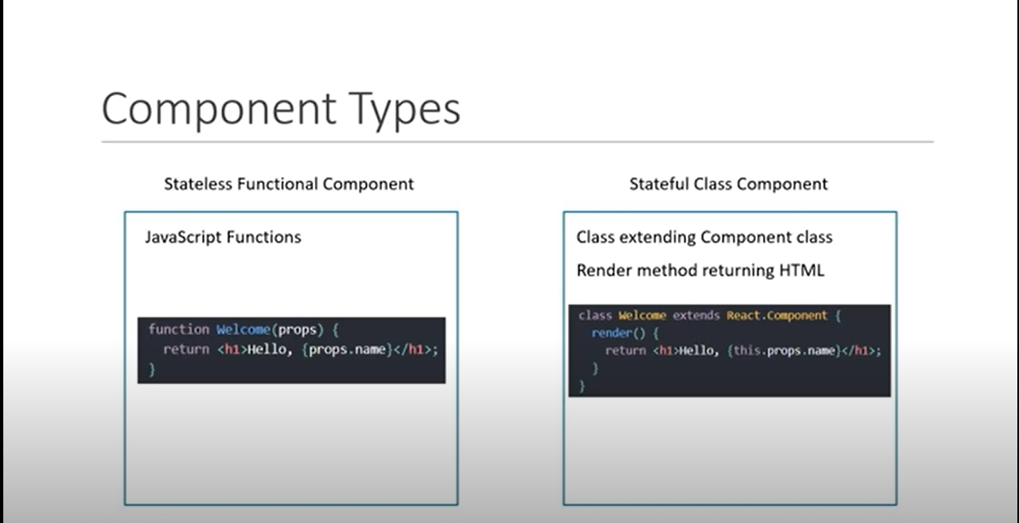

Slide 14
Components Summary
Components Describe a part of user interface
They are re-usable and can be nested inside other components
Two types:-
Stateless Functional Components(Recommended)
Stateful Class Components

Slide 15
JSX
JavaScript XML (JSX) – Extension to the JavaScript language syntax
Write XML like code for elements and components.
JSX have a tag name attributes and children
JSX is not necessity to write React application
JSX make your React code simpler and elegant
JSX is ultimately transpired to pure JavaScript which is understood by the browsers.

Slide 16
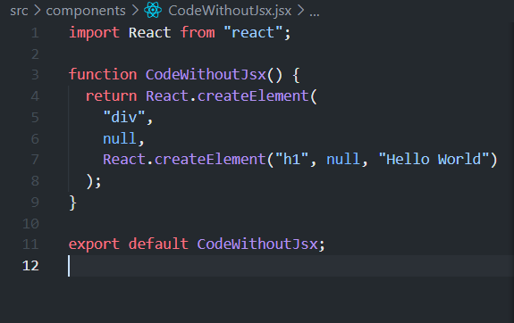
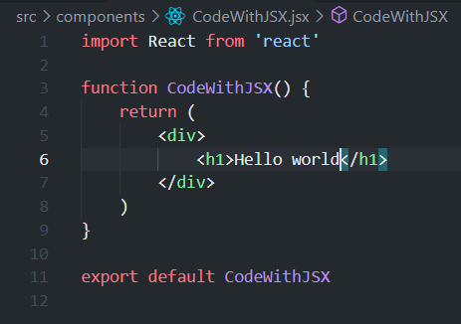
With and without jsx

Slide 17
Props
Short of Property
Helps to be dynamic

